Slide 1

Social Science Research Design and Statistics, 2/e
Alfred P. Rovai, Jason D. Baker, and Michael K. Ponton
Evaluating Bivariate Normality
PowerPoint Prepared by
Alfred P. Rovai
IBM® SPSS® Screen Prints Courtesy of International Business Machines Corporation,
© International Business Machines Corporation.

Slide 2
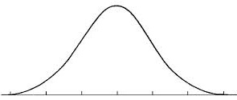
Evaluating Univariate Normality
Normality refers to the shape of a
variable’s distribution. A normally
distributed variable represents a
continuous probability distribution
modeled after the normal or Gaussian distribution, which means it is symmetrical and shaped like a bell-curve.
There are three types of normality: univariate, bivariate, and multivariate normality. Bivariate normality indicates that scores on one variable are normally distributed for each value of the other variable, and vice versa. Univariate normality of both variables does not guarantee bivariate normality, but is a necessary requirement for bivariate normality.
The primary tool available in SPSS to assist one in evaluating bivariate normality is the scatterplot.

Slide 3
Bivariate Normality
The first step in evaluating bivariate normality is to evaluate univariate normality for each variable. If univariate normality is not tenable for either variable, bivariate normality is not tenable.
If univariate normality is tenable, the next step is to determine if a circular or symmetric elliptical pattern exists in a bivariate scatterplot. Bivariate normality is tenable if such a pattern exists and if each variable is univariate normal.

Slide 4
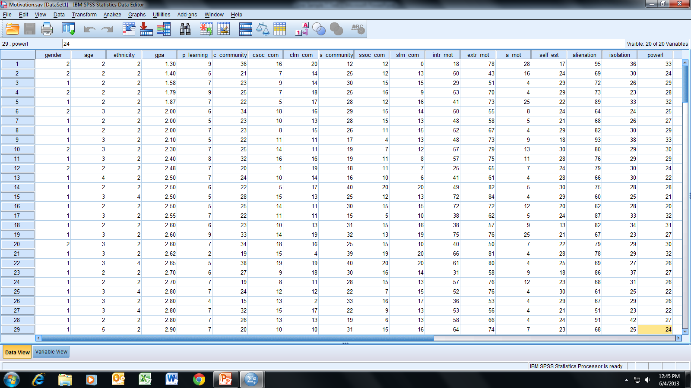
Open the dataset Motivation.sav.
File available at http://www.watertreepress.com/stats
TASK
Evaluate bivariate normality for school
community and intrinsic motivation.

Slide 5
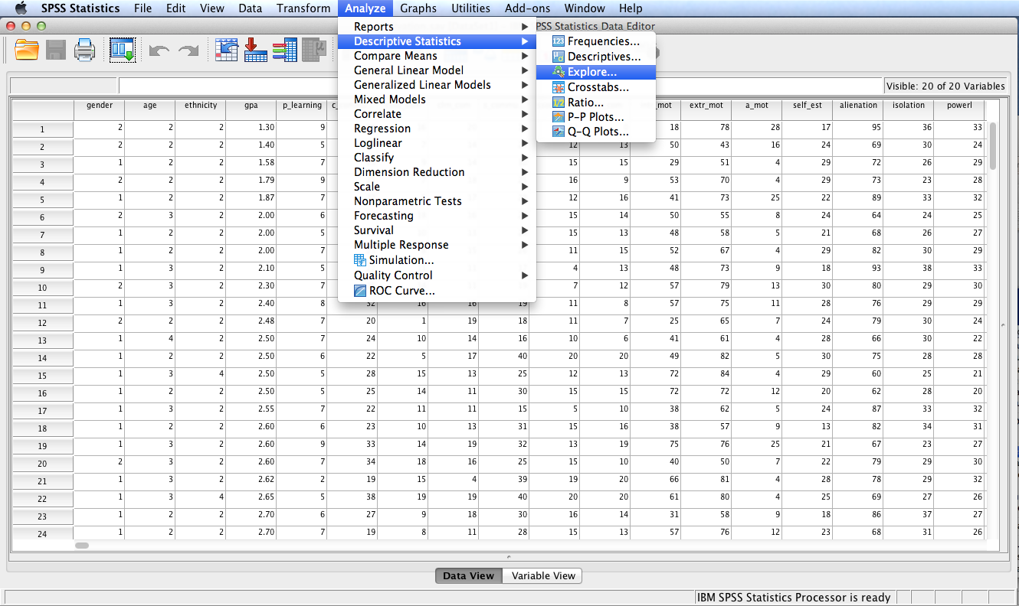
Follow the menu as indicated.

Slide 6
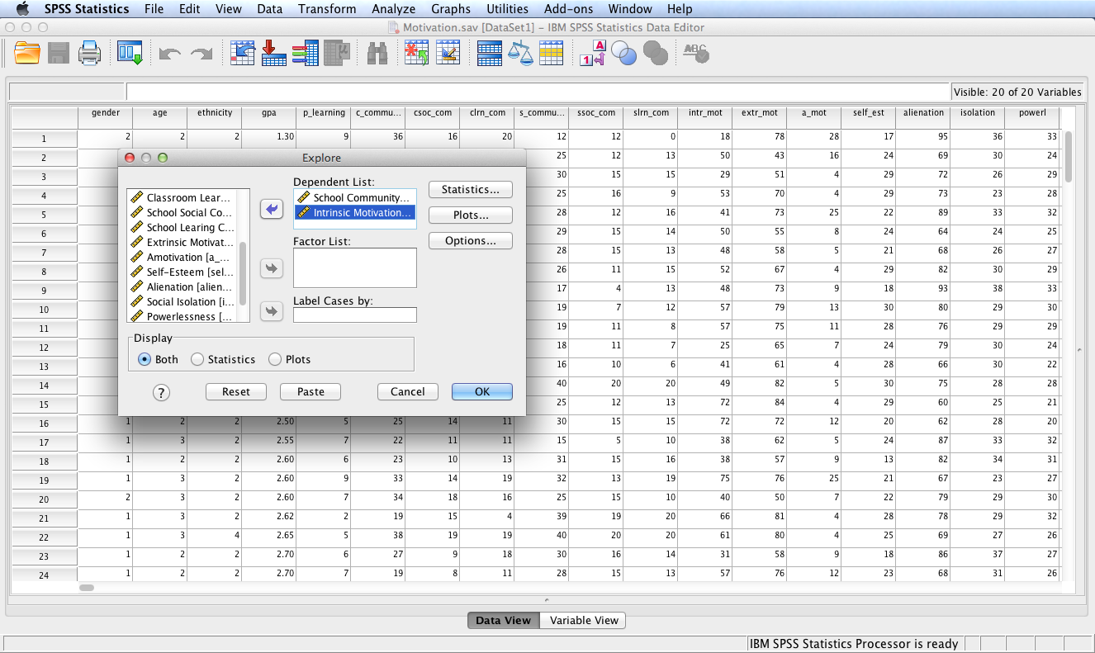
Move variables School Community and Intrinsic Motivation to the Dependent
List: box. Click the Plots…
button.

Slide 7
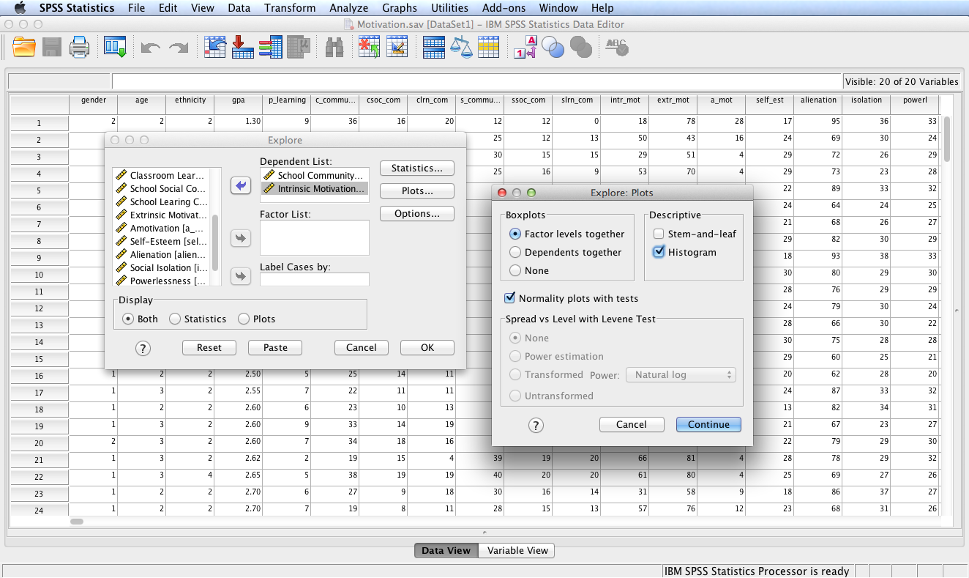
Check the Histogram box and the
Normality plots with tests box.
Click the Continue button and then
the OK button.

Slide 8
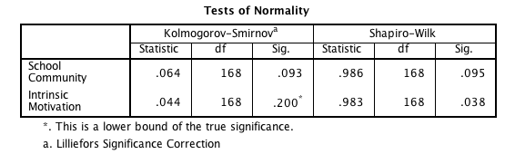
SPSS Output
Since N > 50, the Kolmogorov-Smirnov test the the appropriate statistical test to use to evaluate univariate normality. This test evaluates the following two null hypotheses: There is no difference between the distribution of school community data and a normal distribution and there is no difference between the distribution of intrinsic motivation data and a normal distribution. Test results are not significant (i.e., p > .05 for each test), providing evidence to fail to reject each null hypothesis. Consequently, it can be concluded that both school community and intrinsic motivation scores are normally distributed.

Slide 9
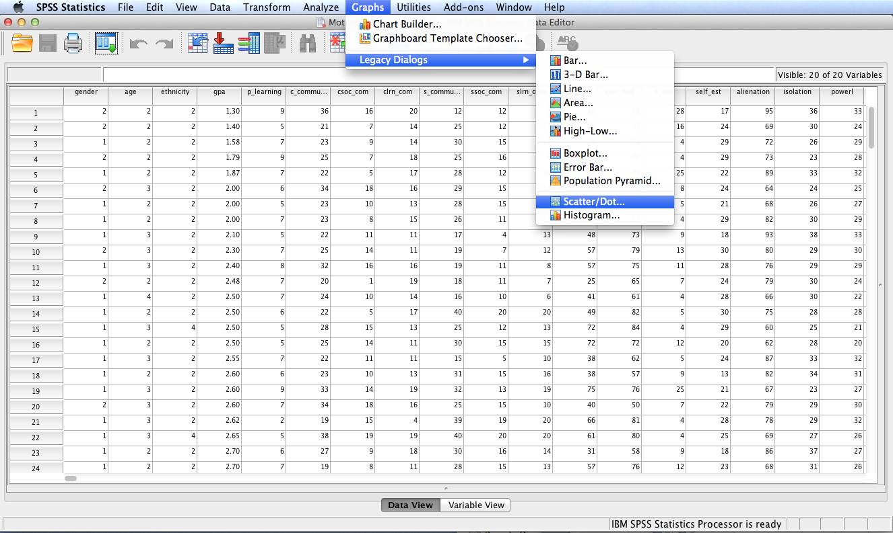
Follow the menu as indicated in order to generate a scatterplot using Legacy Dialogs. Alternatively, use Chart Builder.

Slide 10
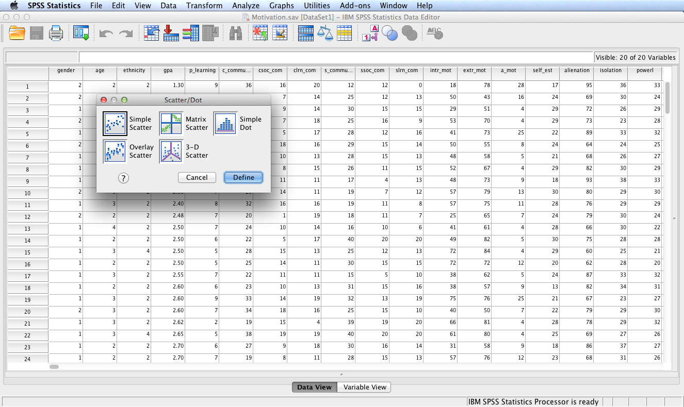
Click the Simple Scatter icon
and then click Define.

Slide 11
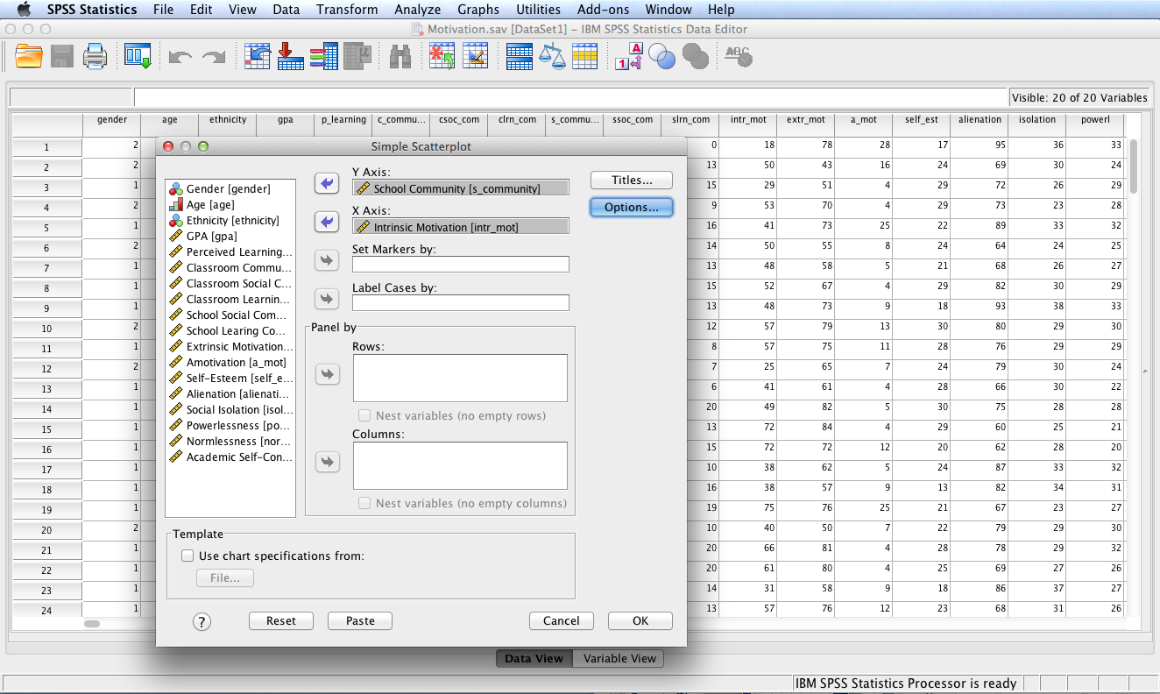
Move the School Community
Variable to the Y Axis: box
and move the Intrinstic
Motivation variable to the
X Axis: box (or vice versa).
Click OK.

Slide 12
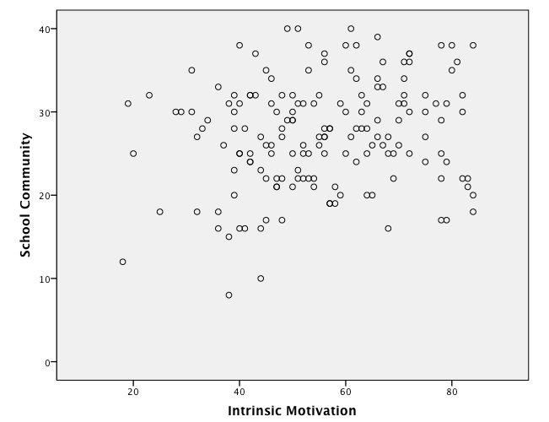
SPSS Output
An approximate symmetric
elliptical pattern is
displayed by the
scatterplot. Therefore
bivariate normality is
tenable since univariate
normality is also tenable
for each variable.

Slide 13
End of Presentation

